Slide 1




FELIX MUKUNGU
Founder, The Core
Bitcoin Educator
Printing Services
MukunguFelix
Felix Divoar
felixdivoar

Slide 2


CHAPTER 4
What is fiat Money ?
& Who Controls it?

Slide 3
We saw in the previous chapter how money evolved over time and how our
monetary system transitioned from sound to unsound money, shaping the
world we live in today. This chapter dives deeper into how these developments led to the fiat system of today and how that fiat system works.
So, what does this fiat system look like, and how did it come into existence?

Slide 4
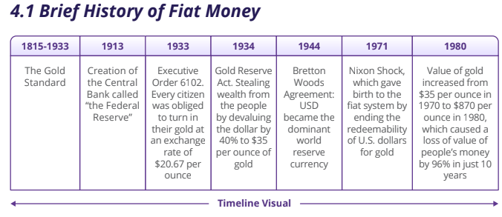

Slide 5

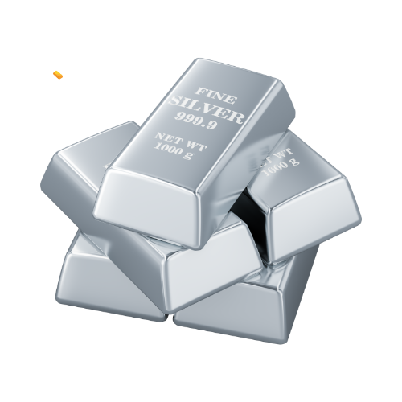
In the 19th century, civilizations worldwide thrived on a sound
money standard, using precious metals like gold and silver due to
their scarcity, durability, and recognizability.

Slide 6
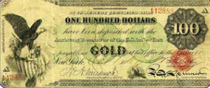
As global trade grew, carrying large amounts of metal became challenging, leading to the emergence of gold and silver warehouses. These warehouses
securely stored people's valuable metals and provided paper certificates redeemable for specific amounts of gold or silver.

Slide 7
Initially, banks aimed to safeguard clients' money but later engaged in risky lending practices, issuing certificates for gold they didn't have. This practice posed the threat of bank runs if too many clients claimed their money simultaneously.
In the early 1930s, a significant change occurred in the way money was backed by assets in the United States. At that time, a lot of people’s wealth was stored in the form of gold. However, in 1933, President Roosevelt issued Executive Order 6102, which demanded that every citizen give up their gold. This wasn't a voluntary exchange – people were required to surrender their gold, and if they refused, they faced severe penalties.

Slide 8
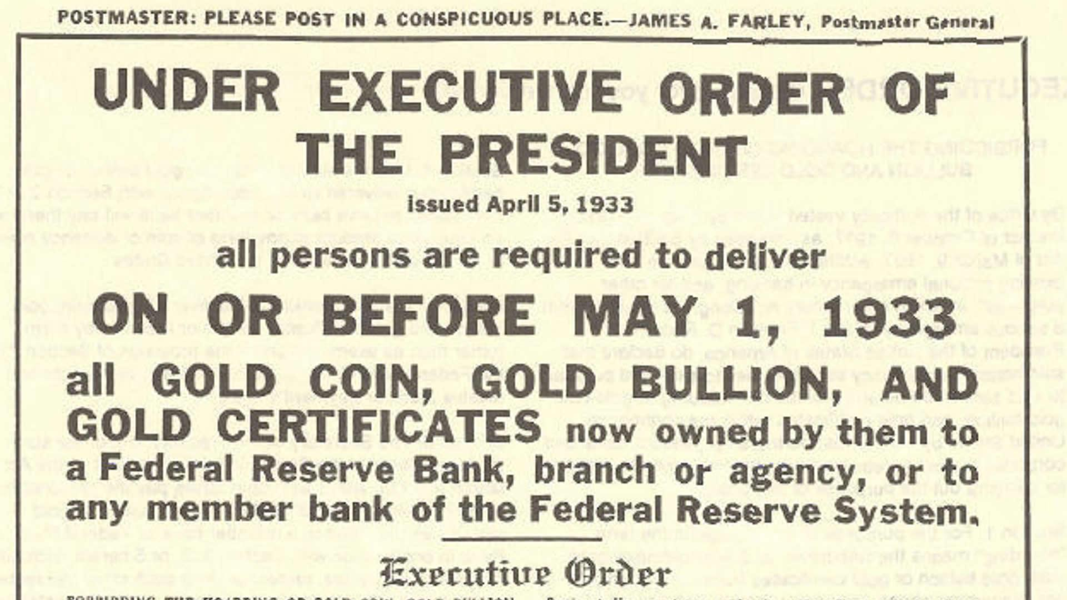

Slide 9
In 1934, the Gold Reserve Act allowed people to exchange their paper dollars for gold again. However, there was a catch: the government deliberately devalued the paper dollars by increasing the exchange rate to $35 per ounce of gold. This devaluation hit hard-working individuals in the lower and middle classes as it meant that their savings, once worth more, were now worth less due to the decrease in the value of the paper dollars.
After World War II, the Bretton Woods agreement in 1944 established the U.S. dollar as the world's reserve currency, and it could be exchanged for gold. However, this link between the U.S. dollar and gold was severed in 1971 when President Nixon ended the redeemability of the U.S. dollar for gold. This marked a significant shift, leading to the adoption of a fiat money system where the value of the currency is not backed by a physical commodity like gold but rather by the trust and confidence of the people who use it.

Slide 10
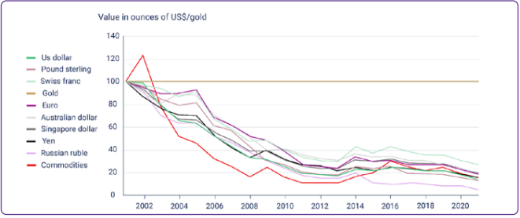

Slide 11
The Fiat System
“
The root problem with conventional currency is all the trust that’s required to make it work. The central bank must be trusted not to debase the currency, but the history of fiat currencies is full of breaches of that trust.
Satoshi Nakamoto

Slide 12
A Monetary System by Decree
The Fiat System is marked by its mandatory nature, imposed on people through legal tender laws. The term "fiat," originating from Latin, means “by decree,” representing a directive issued by authorities. Unlike money backed by tangible assets such as gold, fiat money lacks such support. Instead, its use is mandated by law. Everyday currencies like dollars, euros, pounds, yuans, pesos, and others fall under the category of fiat money.

Slide 13
Pros of Fiat Money
Ease of use: Fiat money is convenient for everyday transactions.
Lower costs and risks: Fiat money doesn’t require heavy security like gold, making it cheaper and safer.

Slide 14
Cons of Fiat Money
Inflation risks: Prices can continuously rise, causing inflation and historical instances of hyperinflation.
Centralized control and manipulation: Small groups can influence and manipulate the system, leading to censorship and confiscation.
Counterparty risk: If the government faces challenges, the currency can lose value.
Potential for abuse: The system can be misused, resulting in corruption and loss of trust.

Slide 15
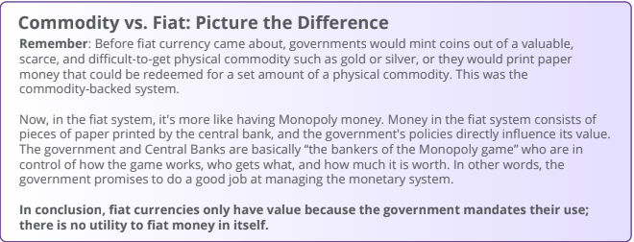

Slide 16
Fractional Reserve Banking: A System Fueled by Debt
It is well enough that people of the nation do not understand our banking and monetary system, for if they did, I believe there would be a revolution before tomorrow morning.
Henry Ford

Slide 17
Fractional Reserve Banking is one of the main parts of the fiat system, allowing banks to lend out a significant portion of their clients' deposits.
Banks are businesses and their primary goal is to make a profit. But how do they make a profit if they let people borrow money?
In addition to earning interest on deposits, banks generate revenue in other ways, including:

Slide 18
Charging interest on loans they give out
Charging fees for services like ATM usage and account
maintenance
Earning money through investments, like buying and selling
securities or investing in real estate
Keeping a percentage of loans in reserve and investing or
lending out the rest
Paying interest on deposits and charging fees on checking and
savings accounts

Slide 19




Banks pay interest from
interest received by lending
(9% - 5% = 4%) and kee the
rest as their profit
Banks borrow money from
depositors at an interest
(let’s say 5%)
Banks lend this money
to borrowers at a higher
(let’s say 9%)

Slide 20
For instance, if you deposit $100 with a 10% reserve requirement, the bank can lend $90, keeping only $10 as reserves. The borrower deposits $90 into another bank, allowing the cycle to continue. Despite the initial $100 deposit, the total money in the economy grows to $271, seemingly appearing out of nowhere – a phenomenon known as the multiplier effect.
This process leads to a debt-driven monetary system as banks create new currency with each loan, increasing the overall money supply. As fractional reserve banking continues, the total debt in the economy rises, contributing to inflation. The system relies on a continuous cycle of currency creation through lending, akin to a steady supply of drugs for an addict. However, if banks lend more money than they have in reserves and depositors rush to withdraw simultaneously, banks could face failure.

Slide 21
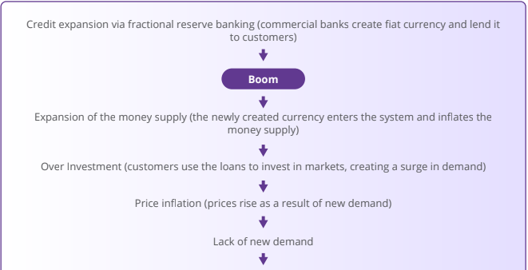

Slide 22
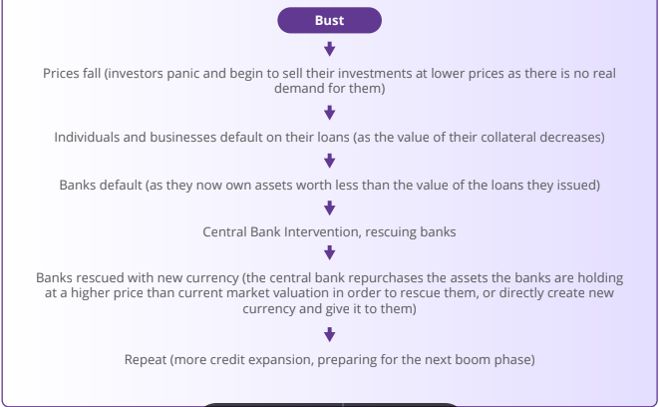

Slide 23
Who Controls the Fiat System and How Do They Benefit?
There are four main players: the government, wealthy individuals, the financial sector, and the central bank.Together, they control the fiat system.
The Government: The government is like the director of the fiat show. Along with tax collection, it is funded through new debt (bonds) issued by the Treasury. When there is insufficient demand for these bonds, any remaining debt is purchased by the central bank. This means they can keep doing their activities and pursuing their interests without needing approval from the people. It's like getting a credit card without worrying about paying it back immediately. This might seem good for the government, but it comes at a cost for everyone else.

Slide 24
Wealthy Individuals: Wealthy individuals benefit a lot from the fiat system. With the ability to accumulate more debt, they can invest in assets like commodities, real estate, and stocks, creating new wealth almost effortlessly.
Financial Sector (banks): Banks and other financial institutions do not directly control the fiat system but greatly benefit from it. Free from accountability, they can pursue and accelerate the creation of new currency via fractional reserve lending, benefiting from higher revenue. Banks are virtually free from consequences as they are bailed out with new fiat currency to prevent the whole system from collapsing.

Slide 25
The Central Bank: The central bank is the one pulling the strings, supposedly controlling the growth of the money supply. But here's the trick — the central bank is also subject to the government's laws, serving the government's interests. It's like a puppeteer being controlled by another puppeteer. The central bank might seem like the one in charge, but it's indirectly serving the government's wishes to print money out of thin air when they need it.
How They Benefit ??
These groups benefit in various ways, creating a complex web of control. The government gets funds without immediate consequences, wealthy individuals and banks make money effortlessly, and the central bank keeps the show running. Meanwhile, the rest of the population might feel the effects, facing challenges as the system unfolds.

Slide 26
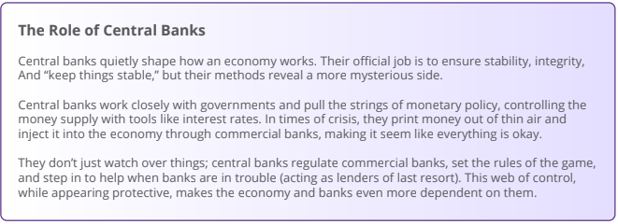

Slide 27
Central Bank Digital Currencies: The Future of Fiat Money
Central Bank Digital Currencies (CBDCs) are the next step of fiat currencies. Unlike the combination of physical bills, coins, and digital payments, CBDCs are fully digital forms of fiat currencies issued by governments and controlled by central banks.
Imagine the currency you use every day but without any physical presence — no coins to jingle in your pocket or bills to fold. What sets CBDCs apart is the heightened level of control and monitoring they offer to governments and central banks. With CBDCs, authorities gain unprecedented visibility into financial
transactions, making it easier to track and regulate the flow of money.
Governments and central banks can readily adjust the form and supply of CBDCs, manipulate interest rates, and deploy monetary and fiscal policy tools with greater precision.

Slide 28
While CBDCs seem the future of fiat money, the world's current monetary system already operates on a pure fiat standard. Fiat currencies are no longer tied to gold, resulting in a significant expansion of the monetary supply without any real restriction. Now that you have a clearer understanding of how the fiat system operates, it's time to explore its consequences in Chapter 5.

